Slide 1




assistant chatbot project
Realised by :
chebbi dhia
coached by :
Benabdallah jasser
CHAABANI NADA

Slide 2

OUTLINE
1
Introduction
2
What is a Chatbot?
3
Role of AI in Chatbot Development
4
Chatbot utilities
5
Chatbot demo
6
How chatbot benefits business
7
Future use of chatbot
8
Conclusion

Slide 3
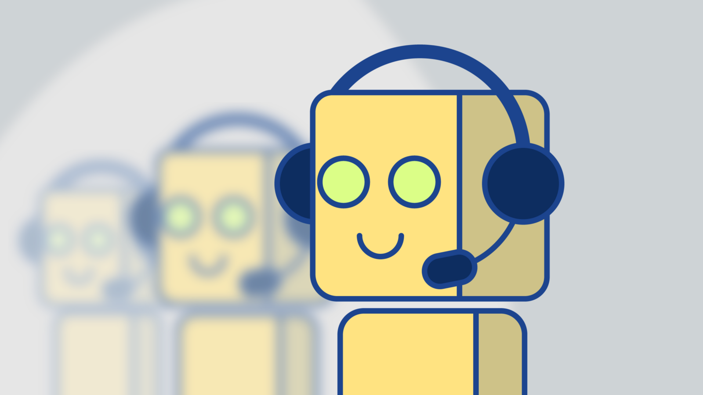
Introduction
Notes:
so in this presentation we will be covering all utilities ,details and aspects of target chatbot after inspecting these parts we will have a great idea of how much that chatbot is important for our environnement .

Slide 4

02
What is a Chatbot?

Slide 5
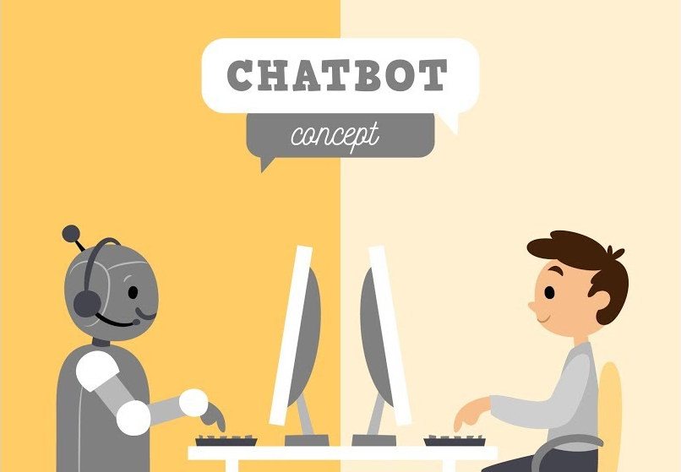
What is a Chatbot?
Definition
Artificial intelligence software
Simulates conversation using natural language
Used for customer service, information gathering or for
action execution
Notes:
A chatbot is an artificial intelligence software that can simulate a conversation with a user in natural language through messaging applications, websites or mobile apps
A chatbot is often described as one of the most used in dialog systems for various purposes including customer service, information gathering or for action execution
It’s known as the most advanced and promising expressions of interaction between humans and machines.

Slide 6
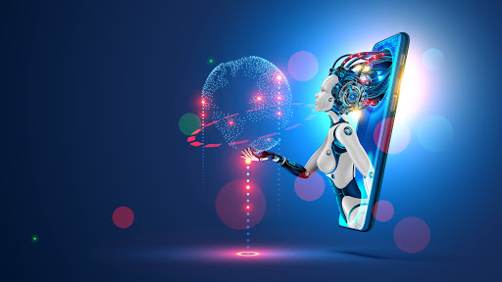
03
Role of AI in Chatbot Development

Slide 7
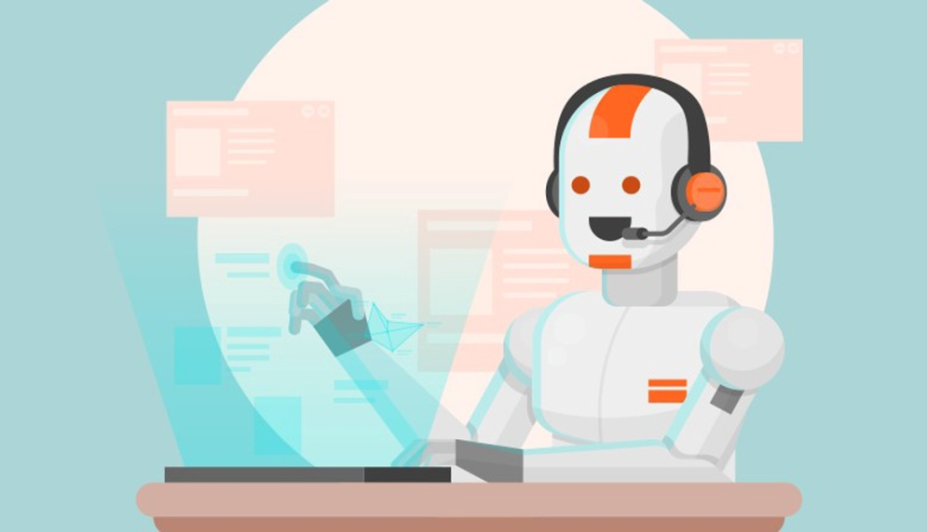


Role of AI in Chatbot Development
capable and intelligent to answer complex queries
Notes:
Chatbot with AI powers makes your bot capable and intelligent to answer complex queries. The interaction is engaging, conversational, and lively.
Smart interactions save customer’s time by helping them to find the right information and address their queries.
AI enables chatbots to perform customer-service tasks without the interference of human emotion or fatigue.
They simply following the direction pointed out by the data.

Slide 8
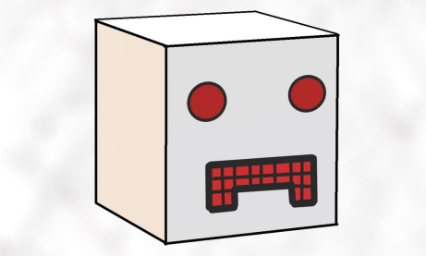

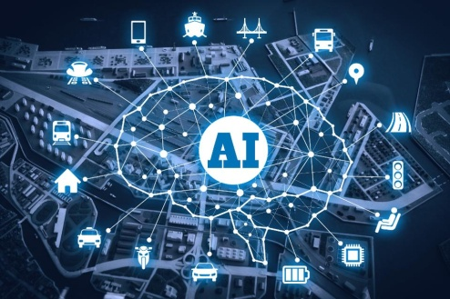
Role of AI in Chatbot Development
bot solving problems and understanding user preferences and choices
Notes:
A chatbot without AI is just a FAQ answering bot.
by adding AI Chatbot learns from every conversation it has with the customers.
It goes through the previous interaction to improve the current response.
This activity helps to improve the efficiency of bot response.
Plus, helps to understand your customer’s choices and preferences.

Slide 9


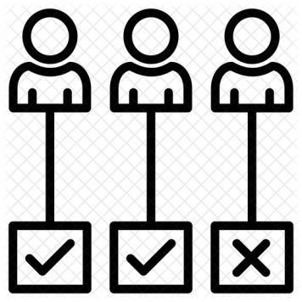

Role of AI in Chatbot Development
Notes:
Building a human-like relationship with customers that can promote brand loyalty, for e.g. sending birthday greetings to clients.
==========➔ Making the conversation look more natural than robotic.
In other words the chatbot by analysing empoyees behivior will get User Manual for all cases

Slide 10
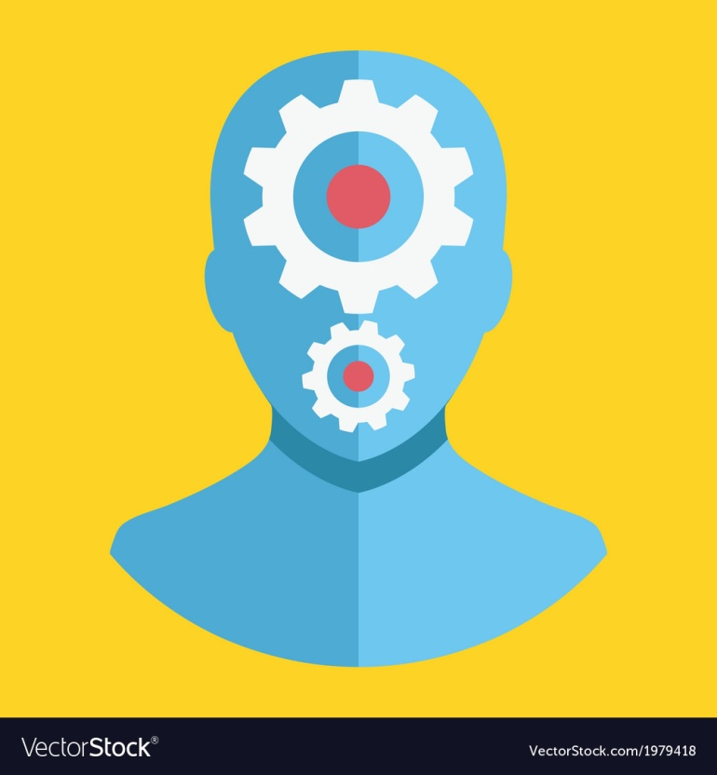
Role of AI in Chatbot Development
machine Learning model
natural language processing and understanding (NLP,NLU)
Notes:
so let's explain how the target bot works without going deep in details :
Our bot starts with the comprehenshion of user messages using multiple techniques like natural language understanding , natural language processing by extrating user intents and needs
In our case I didn’t find much data to make my bot perform intent prediction so I managed creating a python script that generates data and feed it to the model each time
And then to get able to communicate with users and to handle conversation by using nemerous policies (form policy , memorisation and so on )
So in this part of modelling I was busy choosing the right policies that will make my model more accurate and I have tried tuning the hyperparametres and chooing the best augmentation factors to minimize loss

Slide 11
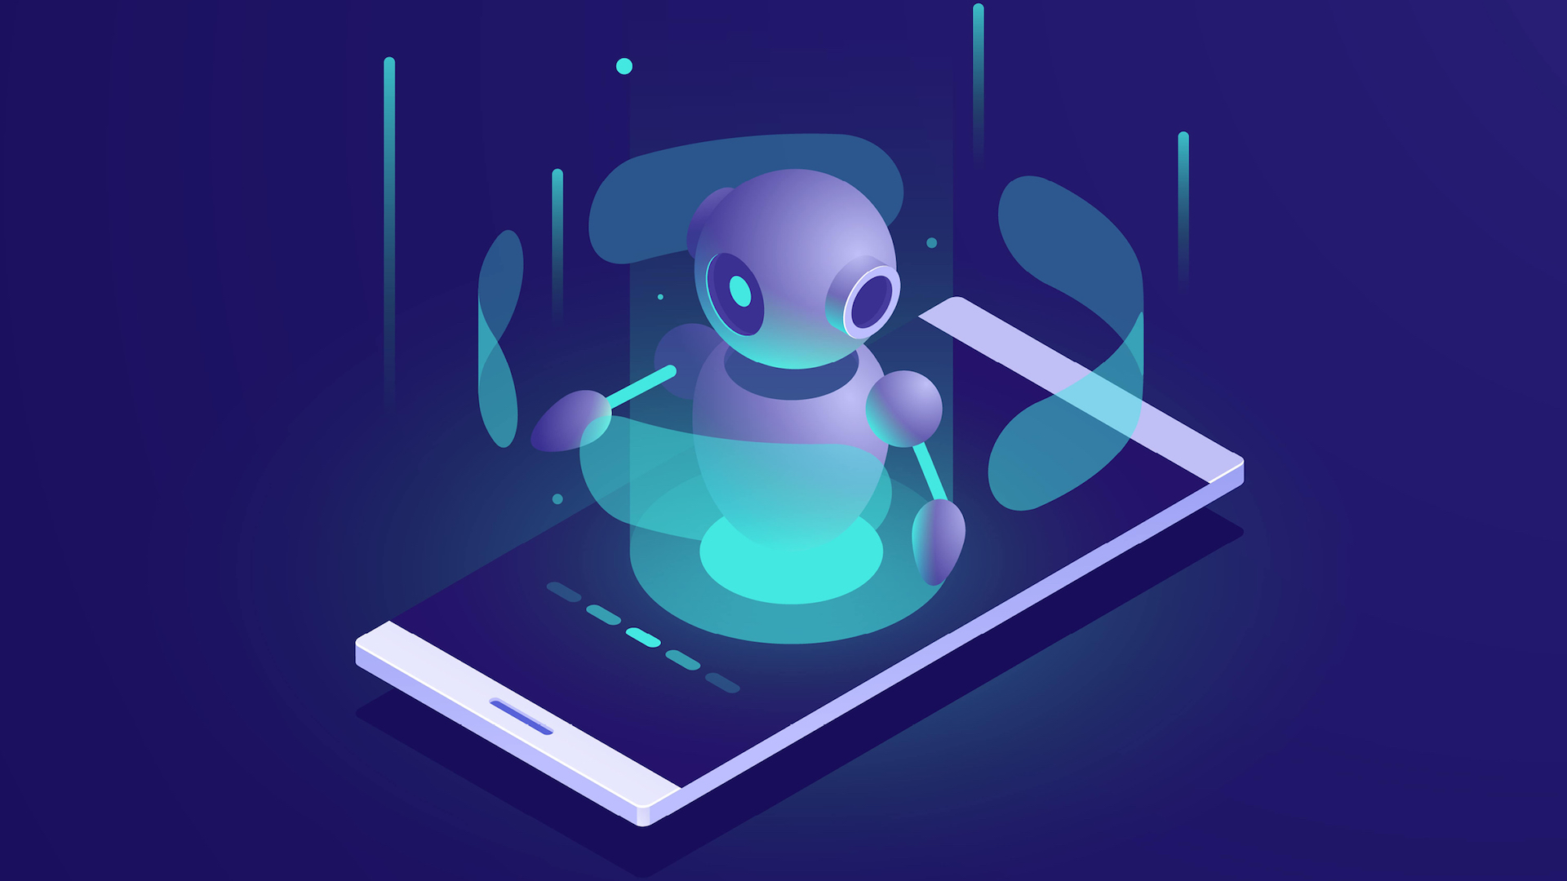
04
Chatbot utilities

Slide 12
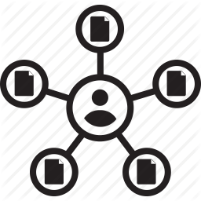


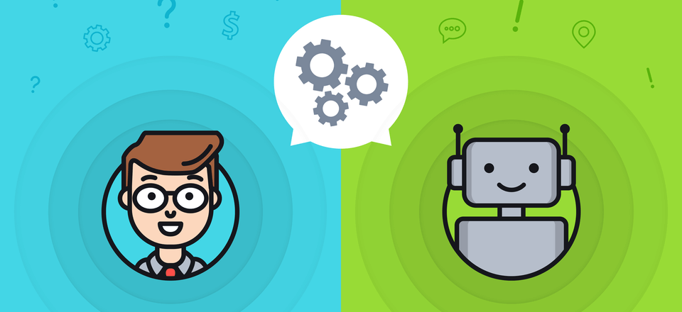
Chatbot utilities
Create workspace
Create stream
Create task
Manage different exceptions related to
creation and suggest solutions
Notes:
Target chatbot functionalities were mainly related to workspace where a user can execute various tasks when talking to the bot
So starting with create workspace :
The bot begins following the need of the user by asking him about workspace name , workspace description , workspace type and so on
Moving to create stream the user is demanded to choose an oranisation , a workspace and a stream name
And finally create task were the bot needs the organisation name , the workspace name the stream_name and the task priority
All these steps are using graphql querries and mutations to get executed
Without forgetting that our bot is managing exceptions , validating user intetnts and suggesting solutions making it easy for employees to satisfy their needs
Like user demands to create task without a stream existant or choosing a workspace name that exists already and so on

Slide 13
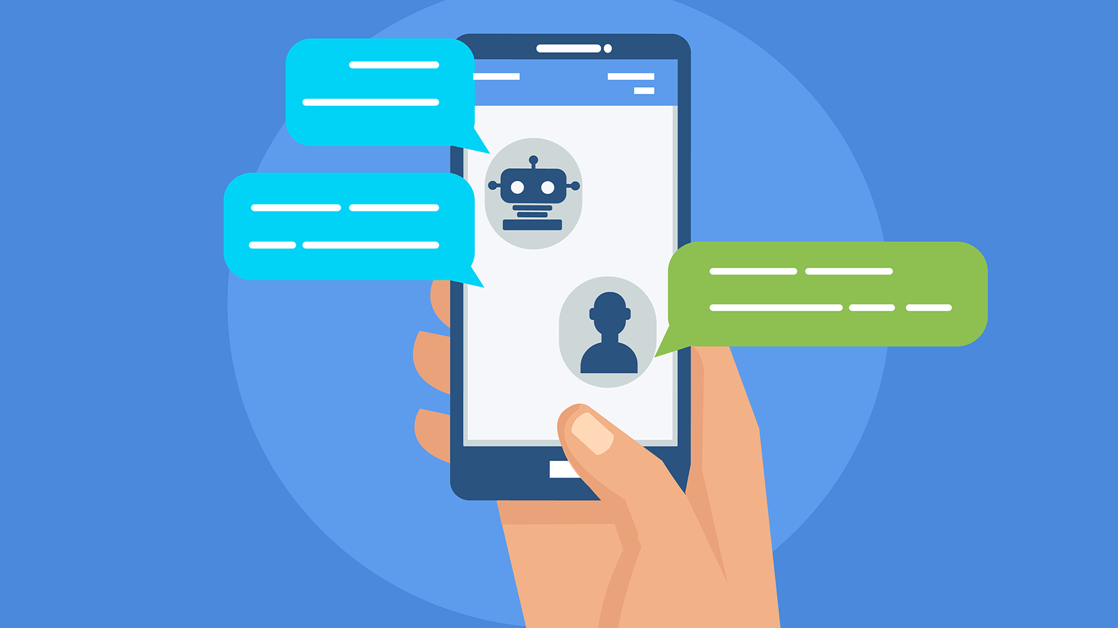
05
Chatbot demo

Slide 14
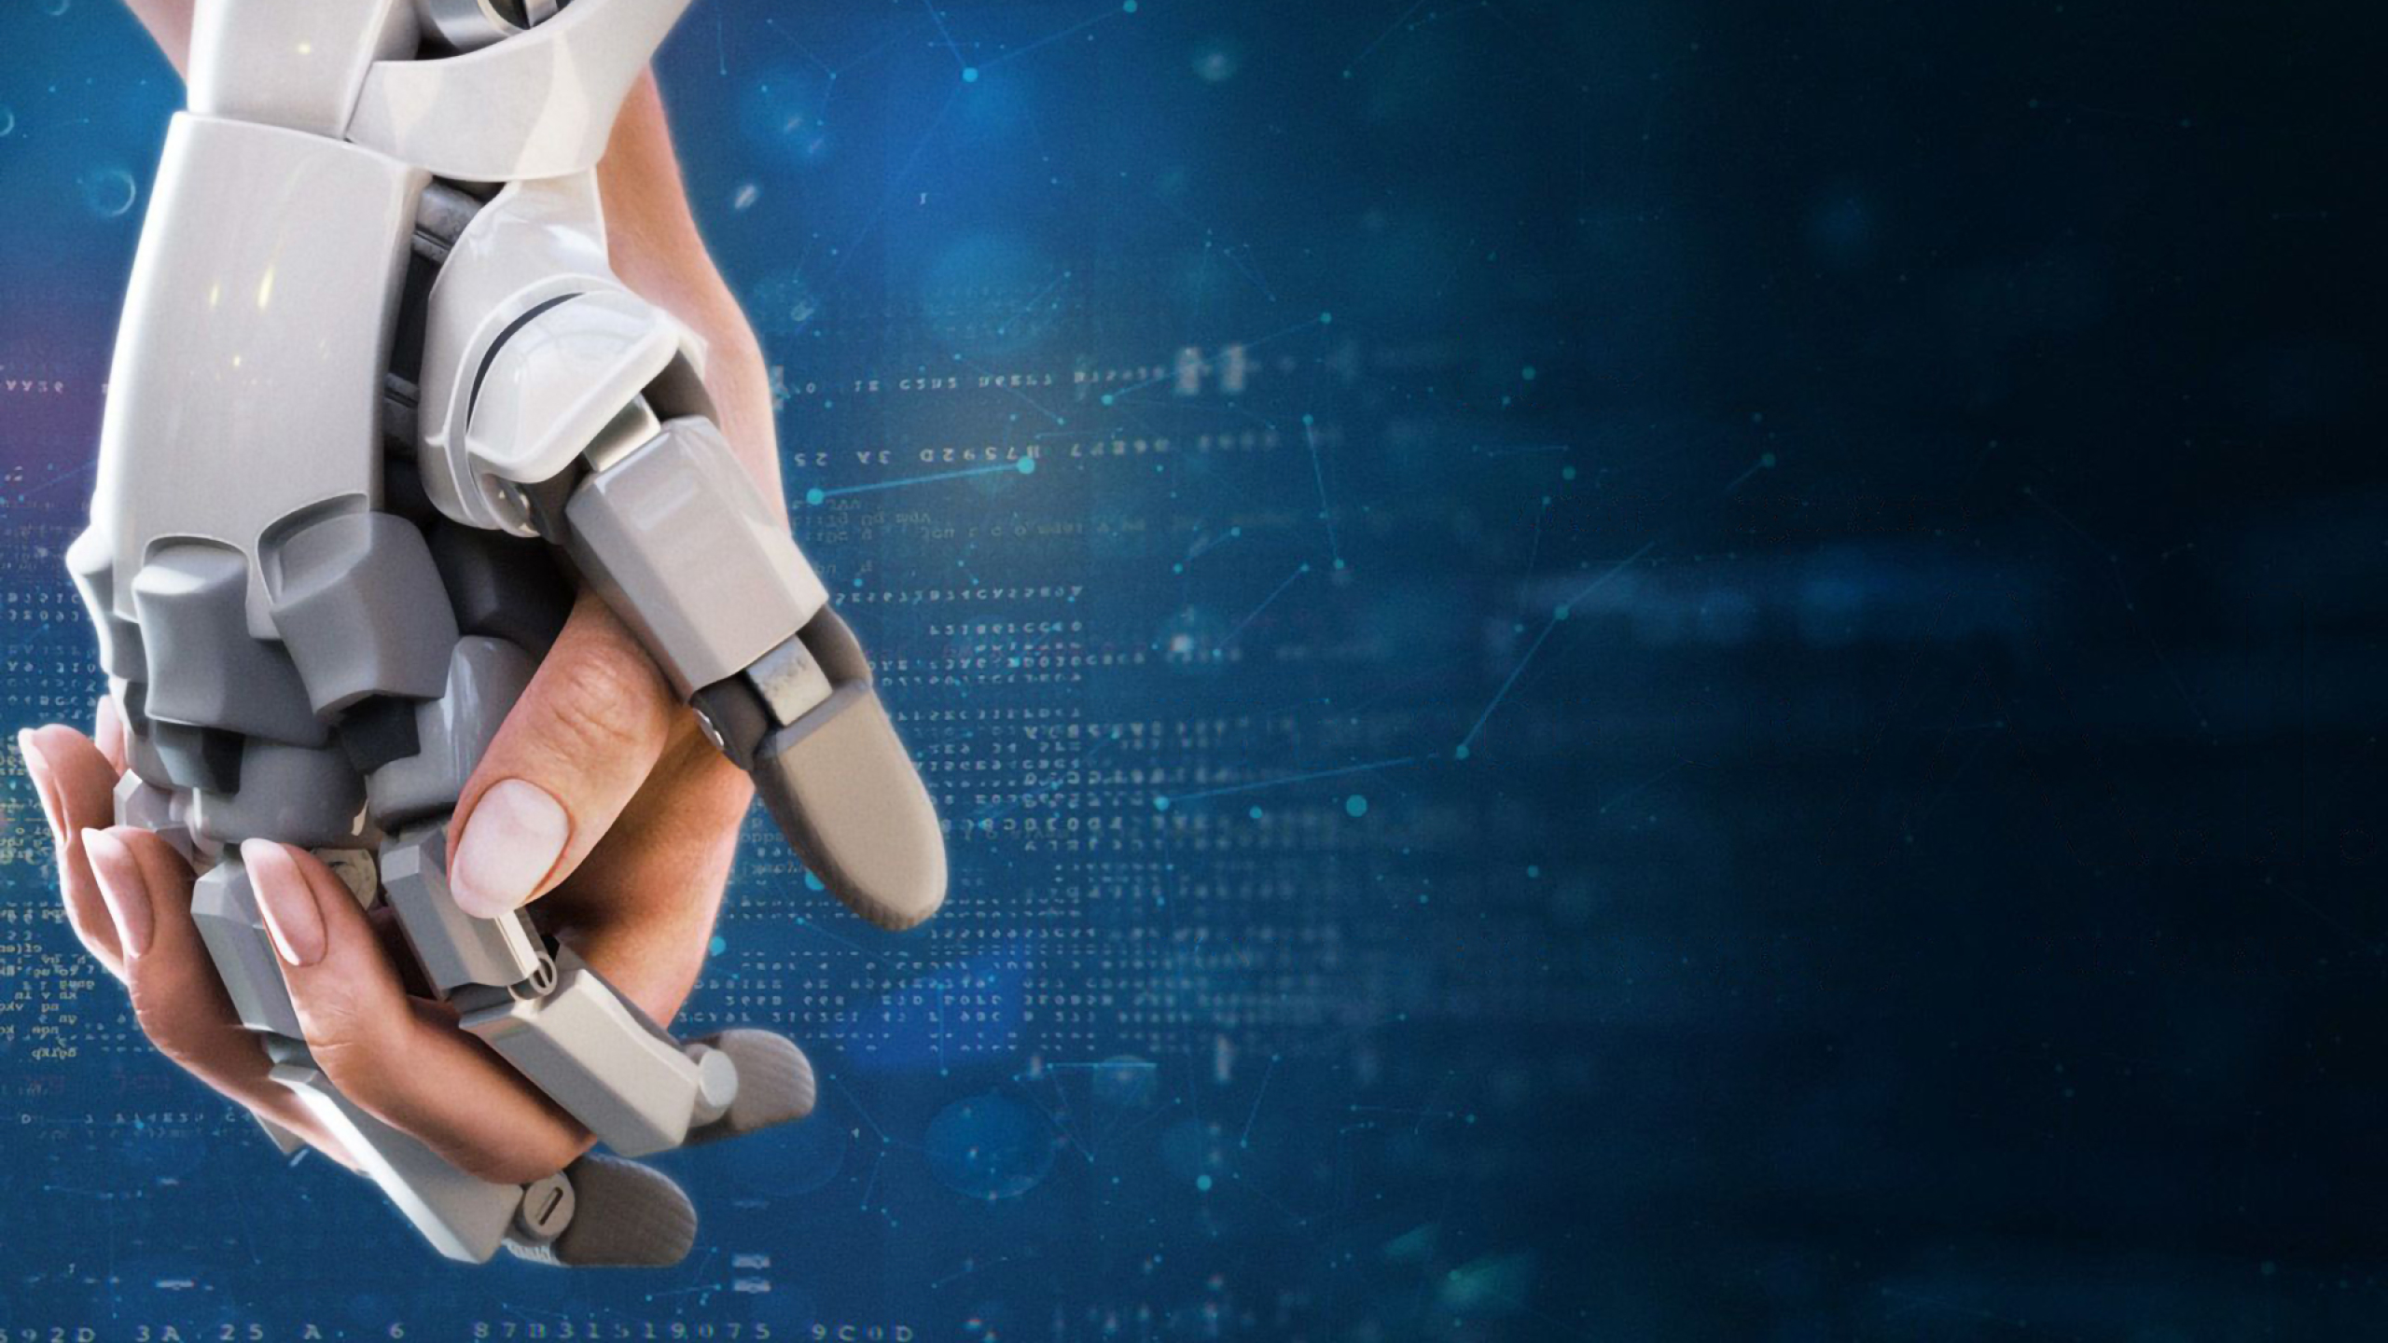
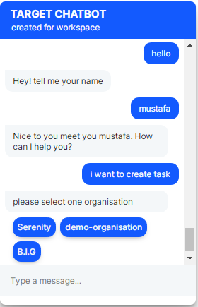
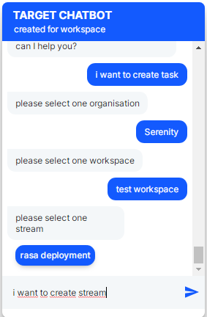
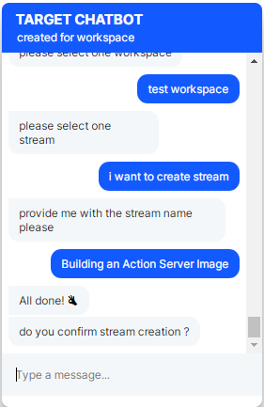
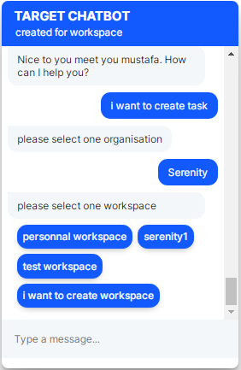
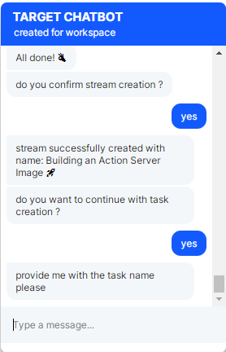
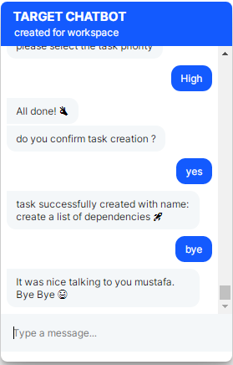
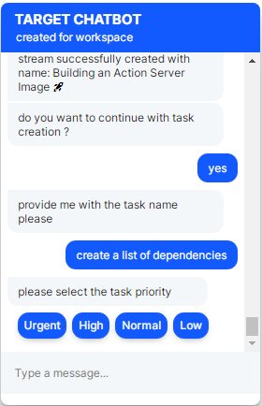

Slide 15
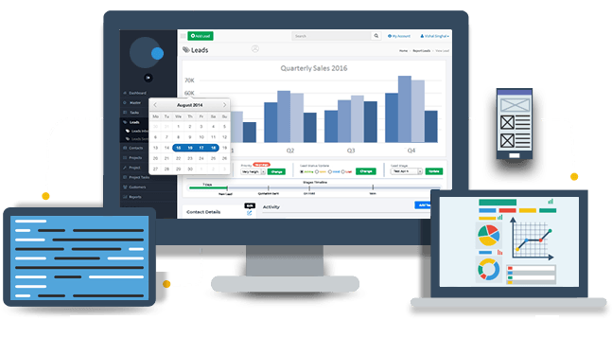
06
How chatbot benefits business

Slide 16



How chatbot benefits business
Extensive employees Assistance
Always Available for employees Support
Notes:
Extensive Customer Assistance
our employeers may require help trying to understand which action fit their needs any time of the day. Moreover, users may not find what they are looking for due to navigation issues when they are on our site that’s why the chatbot will be the best solution
Always-Available Customer Support
Chatbots can handle more tasks at the same time so that no user has to wait

Slide 17


How chatbot benefits business
Monitoring employees Data & Gaining Insights
Notes:
Monitoring Consumer Data & Gaining Insights
With the feedback , answers and the manner of how a service is demanded we can collect those informations and so we can make improvements on our workspace and even optimize the website or have insights in our projects .

Slide 18
07
Future use of chatbot

Slide 19
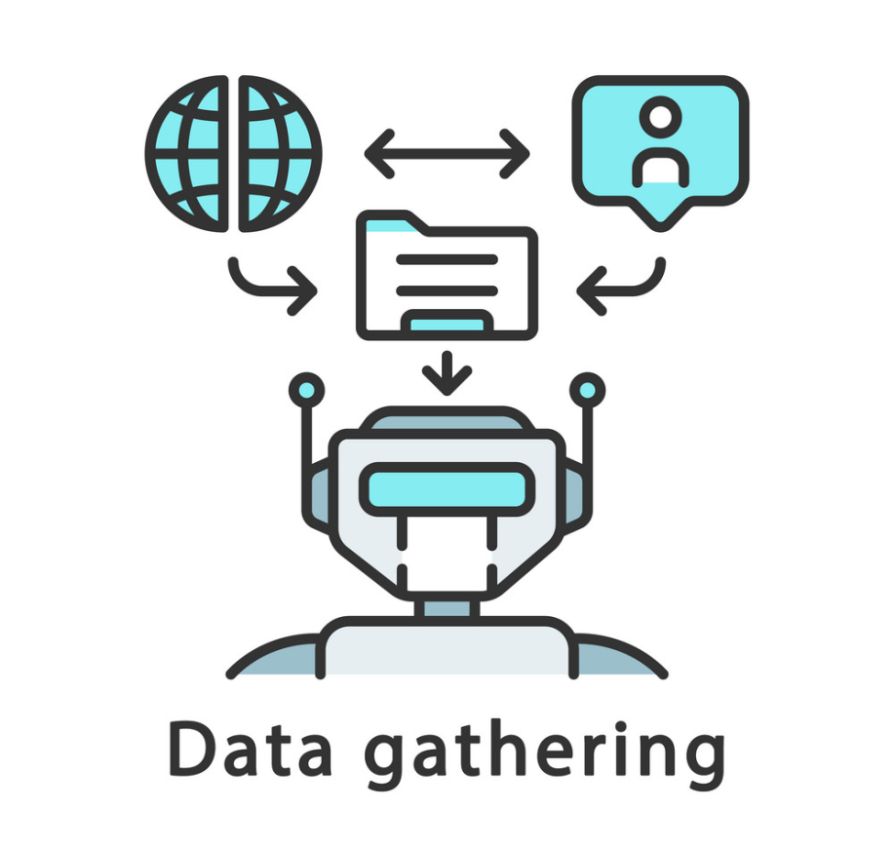
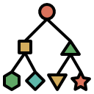
Future use of chatbot
Notes:
As in exemple of target chatbot future use we can track every action executed by every user and then we can create a time series graph determining when we can reach the peak of performance of our employees
under which circumstance employees reach the maximum of productivity
And many other features

Slide 20
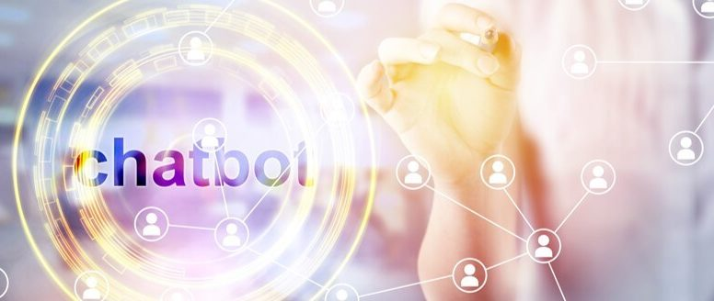
Conclusion
Notes:
During my internship, I got a chance to work in the data department to know about how a software company develops the product as applications
this project was a great opportunity for me to enrich my knowledge and to make use of my studies .

Slide 21

Thank You

